Slide 1



HACK MATRIX HACKATHON
HM10
Code Error Explainer
PROJECT TITLE : ErrorBuddy AI
TEAM NAME : Elevate AI
TEAM MEMBERS : Khushi Roy • Maddala Jashwanth

Slide 2

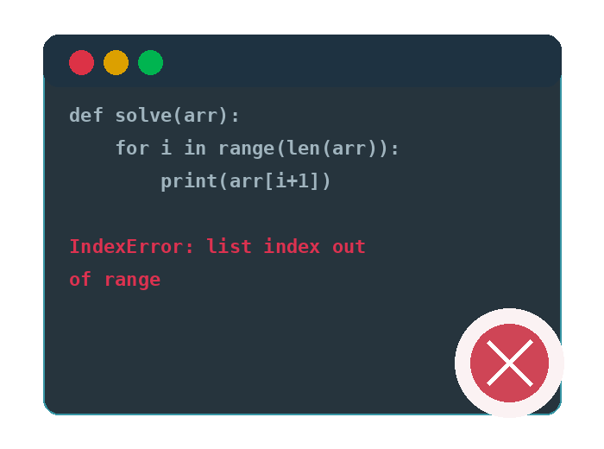
PROBLEM STATEMENT
Problem : Error Messages Are Hard for Beginners
Why this problem is important ?
Debugging tools focus on giving answers, not building understanding
Beginners rely on solutions without learning the logic
Leads to repeated mistakes and weak fundamentals
Increases dependency on external help
Slows down the learning curve
Lowers confidence and motivation
Encourages trial-and-error coding
Reduces overall coding efficiency
Who is affected by this problem .
Students learning programming
Beginner developers
Competitive coders
Self-taught programmers

Slide 3
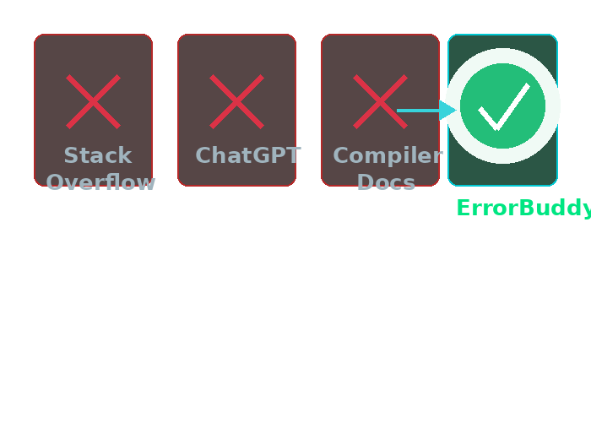
EXISTING SOLUTIONS AND GAPS
Existing tools:
Stack Overflow
ChatGPT
compiler docs
give generic answers with no visual intuition or beginner-friendly fixes.
Limitations:
No auto-corrected code, no live simulations, context-free responses students still spend hours stuck on one error.
Gap Error Buddy Fill :
No system understands a user’s thinking process during coding
Lack of tools to track mistakes over time
No mechanism to prevent repeated errors
Helps users understand concepts while coding visullay by graphs

Slide 4
PROPOSED SOLUTION
Key Features
AI Error Detection & Auto-Fix
Offline Support (Ollama Local Model)
Real-time Visual Simulations
Personalized Learning Mode
Error History & Progress Tracking
Codebase Scanner (Flutter App)
Our Solution
AI-powered debugging copilot
Provides plain-English explanations + auto-fixed code
Generates interactive DSA/ML visualizations
Tracks and learns from user error patterns
Runs in offline mode using Ollama (local LLM)
How It Solves the Problem
Works anytime, even without internet
Reduces dependency on external tools
Converts debugging into a learning experience
Prevents repeated mistakes
Improves speed, understanding & confidence

Slide 5
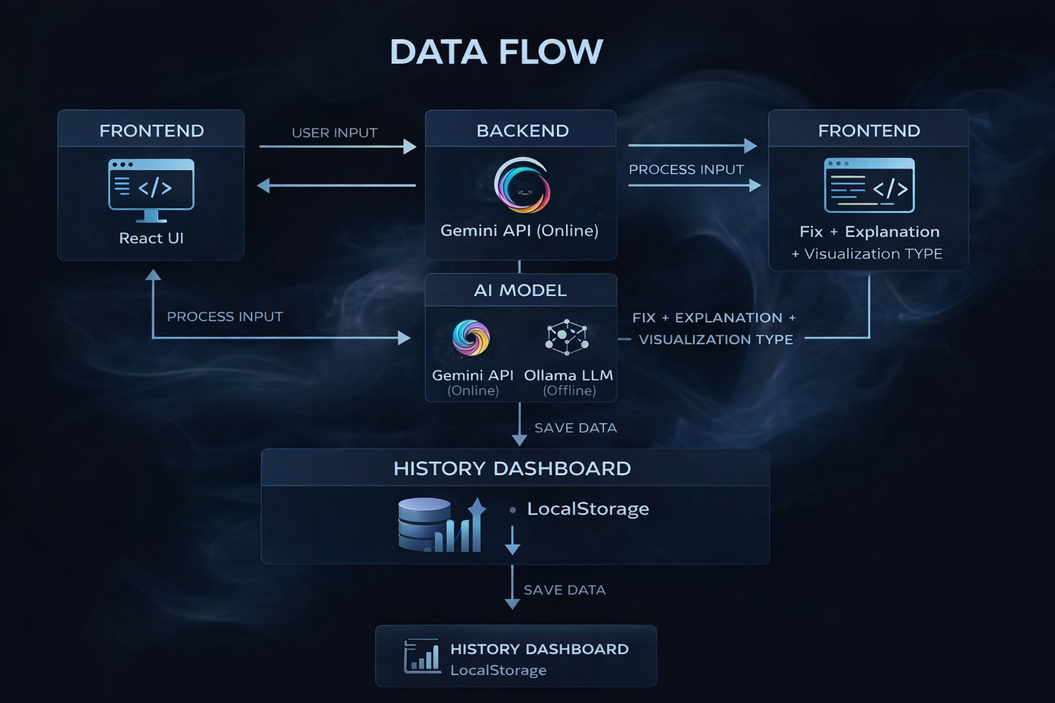
SYSTEM ARCHITECTURE
Frontend (React.js)
User inputs code + error
Backend (Node.js API)
Handles requests & prompt processing
Connects frontend with AI models
AI Engine
Gemini API (online mode) for fast responses
Ollama (offline local LLM) for no-internet usage

Slide 6
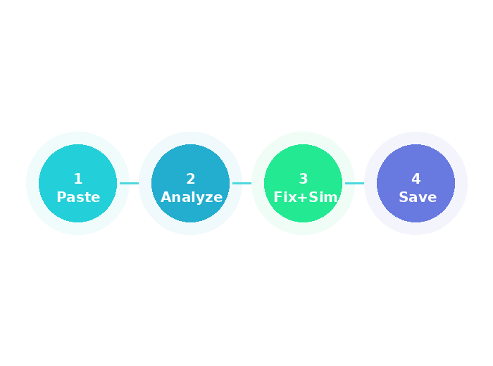
WORKING PROCESS
Step 1: Paste code + error into React web app OR open project folder in Flutter desktop app.
Step 2: Click Explain & Fix → Gemini returns explanation + corrected code + sim type.
Step 3: React renders live DSA/ML simulation. Error saved to History Dashboard.
Smart Processing
Chooses Gemini (online) for fast results
Switches to Ollama (offline) when no internet
Adapts response based on user level & past errors

Slide 7
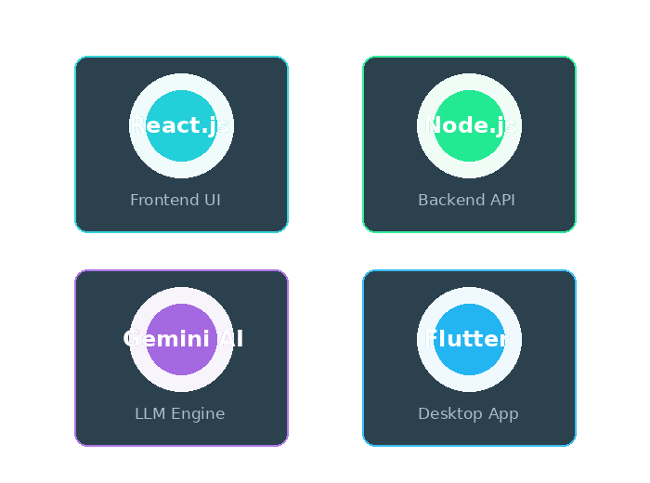
TECH STACK
Frontend: React.js + Tailwind CSS
Backend: Node.js + Express , Gemini API
Database: LocalStorage (web)
AI + Desktop: Gemini 2.5 Flash (LLM) + Flutter (desktop codebase scanner & auto-patcher).

Slide 8
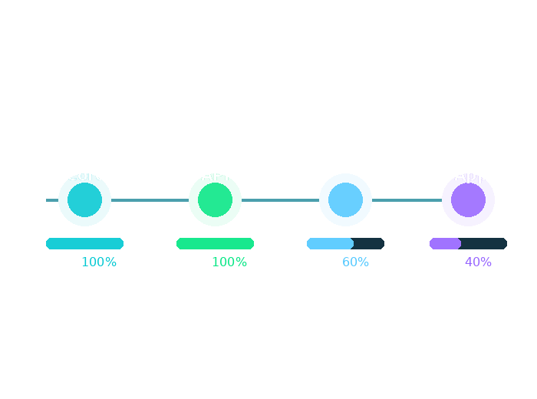
IMPLEMENTATION PLAN
Roadmap: React UI → Gemini API → DSA/ML simulations → Flutter codebase scanner
Modules: Input Interface | Gemini Engine | Mermaid, Manim | History Dashboard | Flutter App
Timeline: Core web prototype → Gemini integration today → Flutter desktop app + visual animations → Full polished prototype ready for offline round tomorrow.

Slide 9
EXPECTED OUTCOME
Working prototype with AI-based error explanation & auto-fix
Generates instant plain-English debugging insights
Supports online (Gemini) + offline (Ollama) modes
Displays interactive DSA/ML visualizations
Tracks errors in History Dashboard
Current Status
Core web prototype built & running
AI integration implemented
Visual simulation module in progress
Flutter desktop scanner partially completed
Results Achieved
Improved concept understanding
Faster and more efficient coding
Reduced dependency on external tools

Slide 10
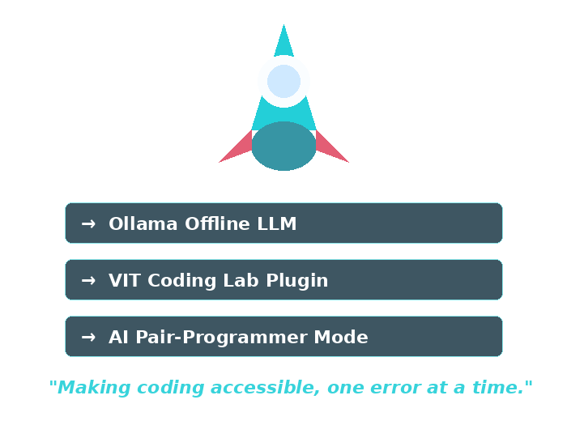
FUTURE SCOPE AND CONCLUSION
Future Scope
Expand DSA/ML visualizations
IDE & browser plugin integration
AI-based pair programming assistant
Scalability
Deploy across colleges & platforms
Multi-language support
Scalable as a SaaS product
ErrorBuddy doesn’t just fix errors it transforms confused coders into confident developers.
“Making coding accessible, one error at a time.”

